Slide 1
Time-Series Forecasting Using Auto encoders
SUBMITTED BY
DHIVYA S
NM ID: au711721104033
KGiSL INSTITUTE OF TECHNOLOGY
3/21/2024 Annual Review

Slide 2
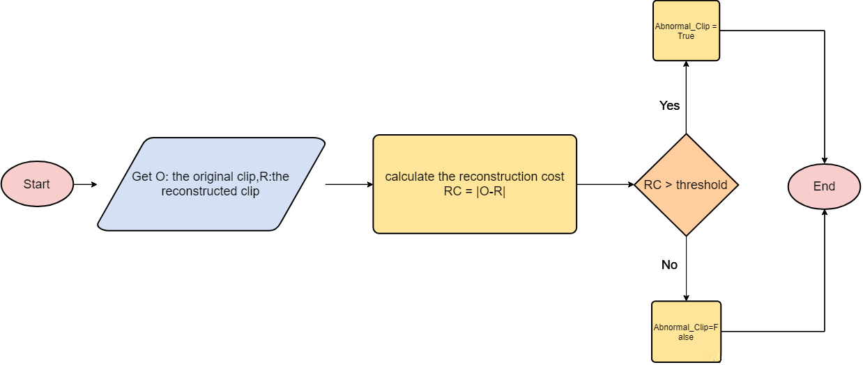
Time-Series Forecasting Using Autoencoders
3/21/2024 Annual Review

Slide 3


AGENDA
PROBLEM STATEMENT
PROJECT OVERVIEW
END USERS
SOLUTION AND PROPOSITION
KEY FEATURES
MODELLING APPROACH
RESULT
3/21/2024 Annual Review

Slide 4

PROBLEM STATEMENT
You work for a retail company that wants to improve its sales forecasting accuracy for multiple products across different store locations. The company currently uses traditional time-series forecasting methods but wants to explore the potential of deep learning techniques, specifically autoencoders, to improve accuracy.
Your task is to develop a time-series forecasting model using autoencoders to predict future sales for each product and store location.
3/21/2024 Annual Review

Slide 5

PROJECT OVERVIEW
A manufacturing company seeks to optimize its production planning and inventory management processes through more accurate sales forecasting. The current forecasting methods are primarily based on statistical techniques, but they often fall short in capturing the intricacies of the sales data. The objective is to develop a time-series forecasting model using autoencoders to predict future sales quantities for each product accurately.
3/21/2024 Annual Review

Slide 6

WHO ARE THE END USERS?
Accurate Forecasting: The primary need is to develop a forecasting model that can accurately predict future sales quantities for each product. Users require forecasts that capture complex temporal patterns, seasonal variations, and other factors influencing sales accurately.
Improved Planning and Decision-Making: Users need reliable forecasts to optimize production planning, inventory management, and resource allocation. Accurate forecasts enable better decision-making regarding production schedules, procurement, and stock levels.
3/21/2024 Annual Review

Slide 7

YOUR SOLUTION AND ITS VALUE PROPOSITION
Model Development: Design and train an autoencoder model suitable for time-series forecasting, capable of capturing complex temporal patterns in the sales data.
Forecasting Model: Develop a separate forecasting model that utilizes the learned representations from the autoencoder to predict future sales quantities for each product.
Evaluation: Evaluate the forecasting model's performance using appropriate metrics such as mean squared error (MSE) or mean absolute error (MAE) on a separate test dataset.
Optimization: Fine-tune the model architecture and hyperparameters to improve forecasting accuracy further.
3/21/2024 Annual Review

Slide 8
THE WOW IN YOUR SOLUTION
Accurate forecasting to support decision-making.
Improved planning and resource allocation.
Automation of forecasting processes.
Adaptability to changing business conditions.
Interpretability and insights into sales trends.
Integration with existing systems and workflows.
Reliability and robustness in forecasting.
3/21/2024 Annual Review

Slide 9
MODELLING
Model Training:
Split the dataset into training and validation sets.
Train the autoencoder model using the training data, minimizing the reconstruction error between the input and output sequences.
Monitor the model's performance on the validation set to prevent overfitting.
Latent Representation Extraction:
Extract the latent representations learned by the encoder part of the autoencoder for each input sequence in the training data.
Forecasting Model Development:
Develop a separate forecasting model (e.g., LSTM, GRU) that utilizes the learned latent representations as input.
Train the forecasting model using the latent representations as features and the actual future values as targets.
3/21/2024 Annual Review

Slide 10
Model Evaluation:
Evaluate the performance of the forecasting model on a separate test dataset using appropriate evaluation metrics such as mean squared error (MSE) or mean absolute error (MAE).
Compare the performance of the autoencoder-based forecasting model with baseline methods to assess improvement.
Fine-tuning and Optimization:
Fine-tune the model architecture and hyperparameters as needed to improve forecasting accuracy further.
Experiment with different configurations to find the optimal model for the given dataset.
Deployment:
Once satisfied with the model's performance, deploy it for making real-time forecasts in the production environment.
Integrate the forecasting model into existing systems or workflows to automate the forecasting process.

Slide 11
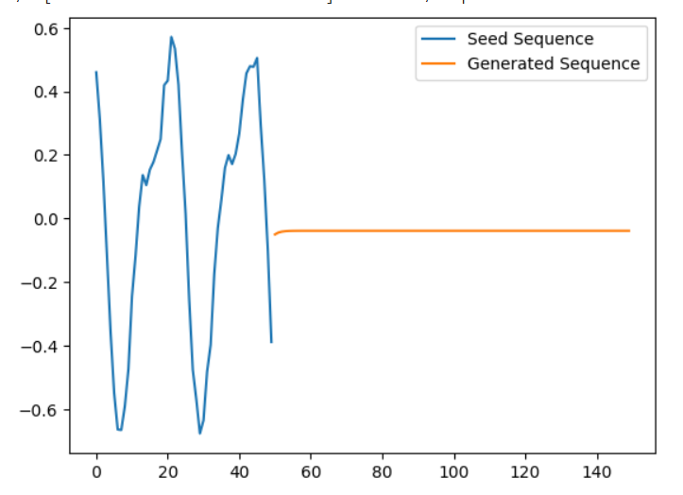
RESULTS
The project's results demonstrate the autoencoder's ability to accurately forecast future values in time-series data, showcasing its effectiveness in capturing temporal patterns and generating precise predictions.
https://drive.google.com/file/d/1E2lLc1FGSRKmYAylv0-BC-nsH2qHvzf7/view?usp=sharing
3/21/2024 Annual Review

